Slide 1

Marri Iacopo
Salamino Manuel
Salazar Molina Steven Alexander

Slide 2

Goals
User goals:
[G.2] Send notification about traffic violations.
[G.3] Add pictures, type of the violation, GPS and time to the violation report.
Authority goals:
[G.4] Check the correctness of a report.
[G.5] Generate traffic ticket from verified reports.
[G.6] Get suggestions about how to improve urban mobility.
Common goals:
[G.1] Access the functionalities of the application from different locations and devices.
[G.7] Access information about unsafe areas.
[G.8] Access statistics about effectiveness of SafeStreets.
[G.9] Access statistics about violations.

Slide 3
World and machine phenomena
World Phenomena
A person leaves the car in an inappropiate place.
A User witnesses a traffic violation.
Shared Phenomena
A User sends a report.
An Authority verifies a report.
SafeStreets shows details about a report.
SafeStreets shows safe/unsafe areas.
Machine Phenomena
SafeStreets computes statistics.
SafeStreets stores received reports.

Slide 4
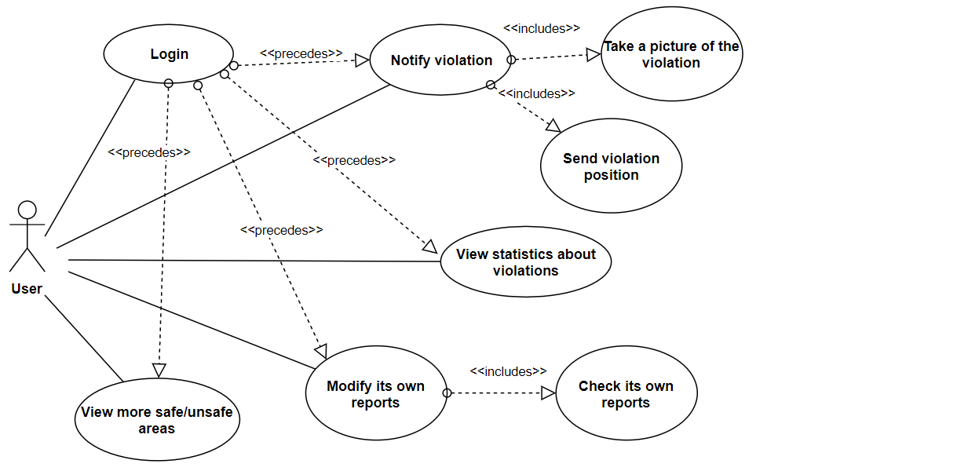
User Use case Diagram

Slide 5
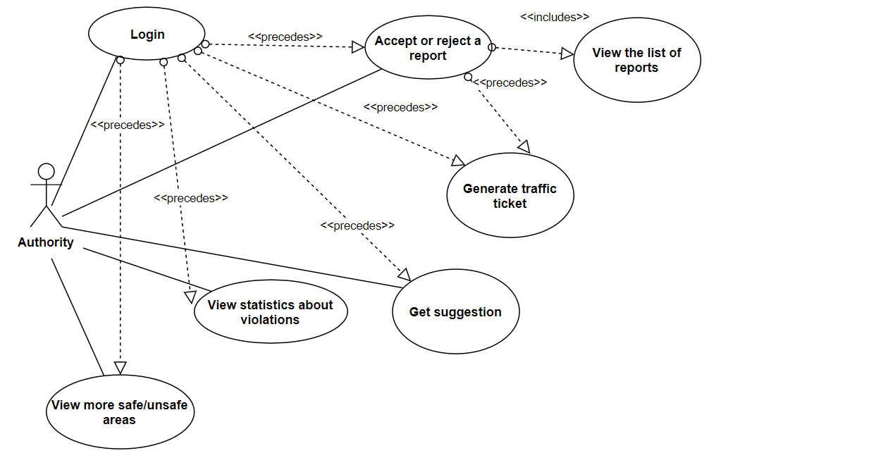
Authority Use case Diagram

Slide 6
[R.6] The System must compute the trustness of reports.
[R.20] The System must communicate with the Authority TrafficTicket Service in order to generate a traffic ticket.
[R.21] The System shall allow the User to send taken pictures by accessing the camera from the SafeStreets application.
[R.22] The System must keep its information about statistics up-to-date with all the reports it received.
[R.23] The System must generate suggestions based on the actual information and the actual urban situation.
REQUIREMENTS

Slide 7
[D.3] The GPS is assumed to be subject to a maximum error of 20meters.
[D.5] Information obtained by Municipality are supposed to be correct.
[D.7] Is assumed that the camera used by the User’s device is working properly.
[D.9] Is assumed that the Municipality offers an API to access their urban mobility data.
ASSUMPTIONS

Slide 8
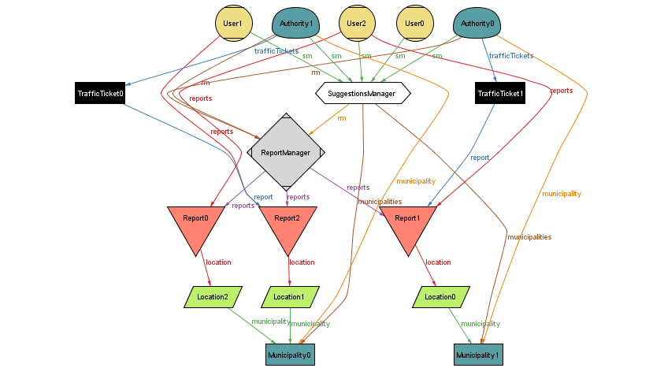
ALLOY

Slide 9
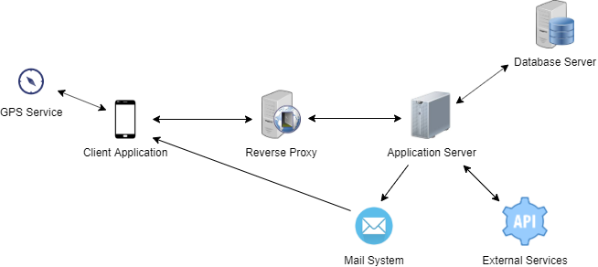
System overview

Slide 10
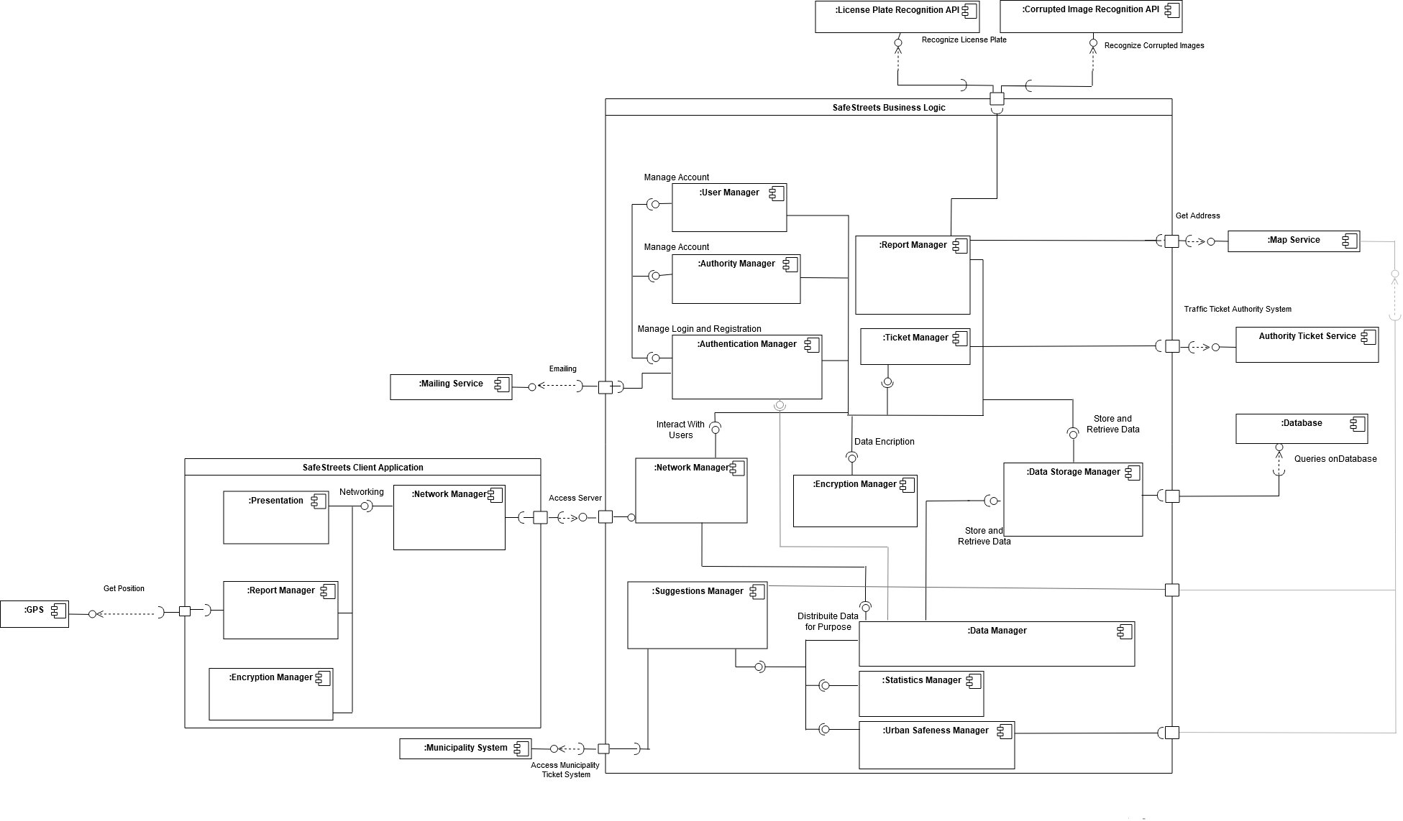
COMPonent diagram

Slide 11
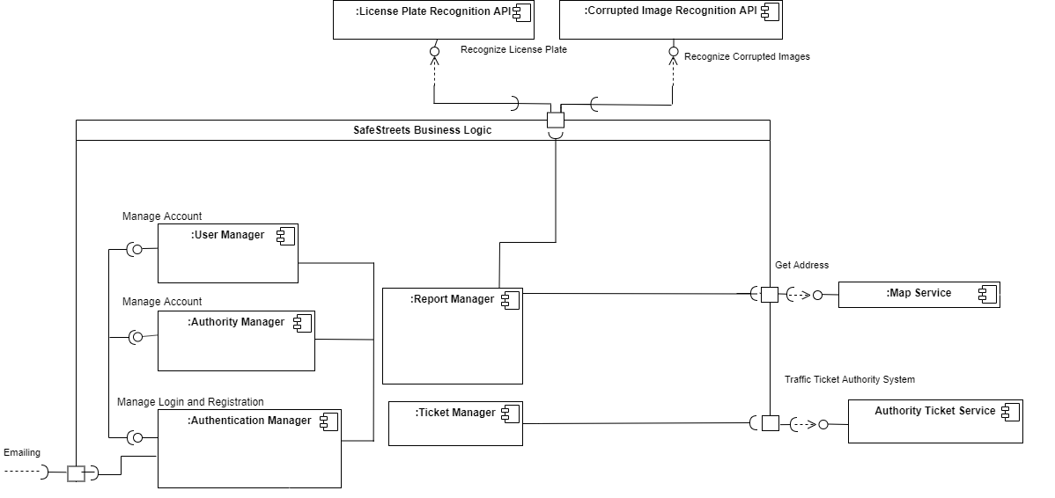
MEANINGFUL INTERACTIONS

Slide 12
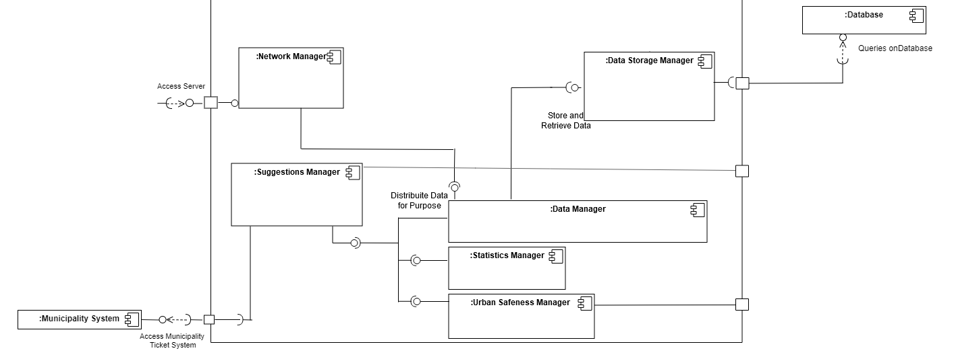
MEANINGFUL INTERACTIONS

Slide 13
Multi-Tier Architecture:
Guarantees that each tier only deals with a specific task, creating a flexible and reusable application.
REST:
Allows data exchange through HTTP protocol and stateless operations improving interoperability between systems.
RDBMS:
A Relational DBMS improves accuracy, flexibility, security and guarantee an easy management.
Observer:
Improves the scalability of the system, making easier to add new components or functionalities.
DESIGN CHOICES AND PATTERNS

Slide 14
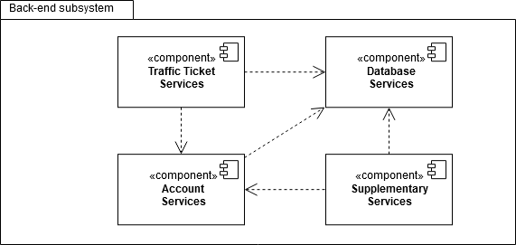
Bottom-up approach:
As a first step, implementation and testing of single component of the same subsystem.
The subsystems will be integrated and tested together.
Testing the correct behaviour of the system.
IMPLEMENTATION PLAN

Slide 15
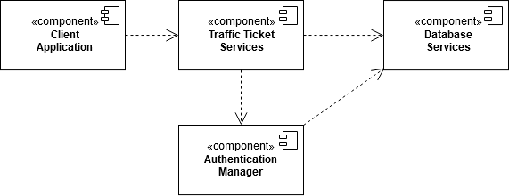
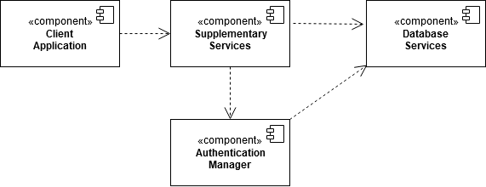
Bottom-up approach:
As a first step, implementation and testing of single component of the same subsystem.
The subsystems will be integrated and tested together.
Testing the correct behaviour of the system.
IMPLEMENTATION PLAN

Slide 16
IMPLEMENTATION PLAN
Functionality | Importance for the customer | Difficulty of implementation
Sign up and login | low | low
Report a violation | high | high
View old reports | medium | low
View Statistics | low | medium
View Suggestions | medium | high
View Safe/Unsafe areas | high | medium

Slide 17
Thanks for your attention

